Slide 1

Stats Bootcamp
MSc in Analytics
Dr. Anil D Chaturvedi
Email: anilchaturvedi@uchicago.edu
Phone: 301-299-2434

Slide 2
Welcome to Stats Bootcamp
1/25/2015 – Dr. Anil D Chaturvedi The University of Chicago

Slide 3
Session 5: Topics
ANOVA Introduction
ANOVA Designs
One-way ANOVA
Multi-factor ANOVA
Unequal Sample Sizez
Tests supplementing ANOVA
Within Subjects ANOVA
1/25/2015 – Dr. Anil D Chaturvedi The University of Chicago

Slide 4
ANOVA

Slide 5
Analysis of Variance
Comparing 2 or more means
Inferences about means based on variances
Notes:
Analysis of Variance, also called ANOVA, is a statistical method used to compare two or more means. It may seem odd that the technique is called "Analysis of Variance" rather than "Analysis of Means." The name is appropriate because inferences about means are made by analyzing variance.

Slide 6
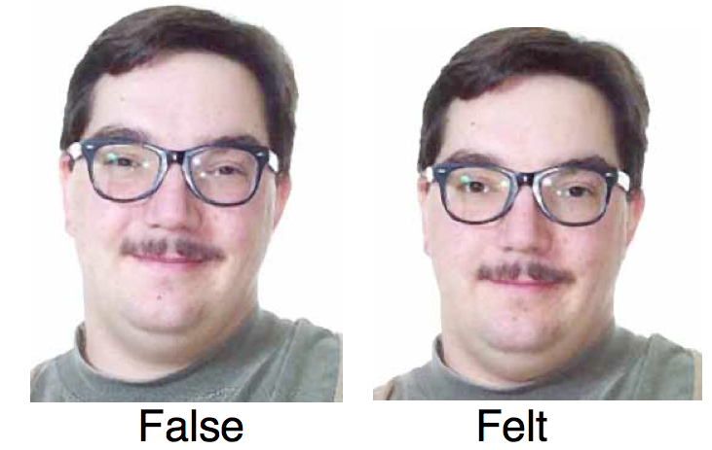
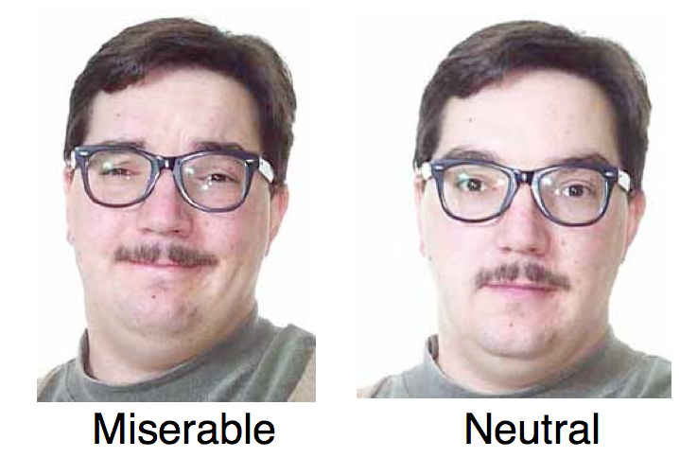
Smiles and Leniency
Notes:
ANOVA is used to test general rather than specific differences among means. This can be seen best by example. In the Smiles and Leniency case study, the effect of different types of smiles on the leniency shown to a person was examined. Four different types of smiles (neutral, false, felt, and miserable) were investigated to see how they might attenuate judgments of possible wrongdoing.

Slide 7
Comparing the Conditions
Comparison | M_{i}-M_{j} | Q | p
False - Felt | 0.46 | 1.65 | 0.649
False - Miserable | 0.46 | 1.65 | 0.649
False - Neutral | 1.25 | 4.48 | 0.010
Felt - Miserable | 0.00 | 0.00 | 1.000
Felt - Neutral | 0.79 | 2.83 | 0.193
Miserable - Neutral | 0.79 | 2.83 | 0.193
Notes:
One way to compare the four different smiles’ impacts on the leniency shown is to test the differences among means with the Tukey HSD test, as described in the section “All Pairwise Comparisons among Means". The results from the Tukey HSD test are shown in this table.
Notice that the only significant difference is between the False and Neutral smile conditions.

Slide 8
Hypothesis Tested by ANOVA
Notes:
ANOVA tests the non-specific null hypothesis that all four populations’ means are equal. That is,
μfalse = μfelt = μmiserable = μneutral.
This non-specific null hypothesis is sometimes called the omnibus null hypothesis. When the omnibus null hypothesis is rejected, the conclusion is that at least one population mean is different from at least one other mean. However, since the ANOVA does not reveal which means are different from which others, it offers less specific information than the Tukey hsd test. The Tukey hsd is therefore preferable to ANOVA in this situation. Some textbooks introduce the Tukey test only as a follow-up to an ANOVA. However, there is no logical or statistical reason why you should not use the Tukey test even if you do not compute an ANOVA.

Slide 9
Why Learn ANOVA
ANOVA can be generalized to more complex designs
Commonly used so it is important to understand it
Notes:
You might be wondering why you should learn about ANOVA when the Tukey test is preferable. One reason is that there are complex types of analyses that can be done with ANOVA and not with the Tukey test. A second is that ANOVA is by far the most commonly-used technique for comparing means, and it is therefore important to understand ANOVA in order to understand research reports.

Slide 10

Analysis of Variance
(ANOVA) Designs
Notes:
There are various types of experimental designs that can be analyzed by analysis of variance (sometimes called ANOVA). This section discusses many of these designs and defines many key terms used.

Slide 11
Factors and Levels
4 types of smiles
4 levels of the factor
Notes:
An independent variable is a variable manipulated by the experimenter. In the Smiles and Leniency case study, the effect of four different types of smiles (neutral, false, felt, and miserable) on the leniency shown to a person was investigated. In this experiment, the type of smile is the independent variable. In describing an ANOVA design, the term factor is used as a synonym of independent variable. Therefore, "Type of Smile" is the factor in this experiment. Since four types of smiles were compared, the factor "Type of Smile" has four levels.

Slide 12
One-way vs. Two-way ANOVAs
One-way ANOVA: only one factor
Two-way ANOVA: two factors
Notes:
A one-way ANOVA is an ANOVA conducted on a design in which there is only one factor, such as in the Smiles and Leniency case study. If an experiment has two factors, then the ANOVA is called a two-way ANOVA. The data from the Obesity and Bias case study can be analyzed with a two-way ANOVA. This case study examines the effects of two factors, the weight of the woman sitting next to the applicant and the relationship between the applicant and the woman, on ratings of job qualification.

Slide 13
Between-Subjects Factors
Different subjects used for the different levels of the factor
Example: “Type of Smile” in the Smiles and Leniency case study
Notes:
In the Smiles and Leniency study, the four levels of the factor "Type of Smile" were represented by four separate groups of subjects. When different subjects are used for the different levels of the factor, the factor is called a between-subjects factor or a between-subjects variable. The term "between subjects" reflects the fact that comparisons are between different groups of subjects.

Slide 14
Within-Subjects Factors
Same subjects used for the different levels of the factor
Also called repeated-measures variables
Example: “Dosage” in the ADHD Treatment case study
Notes:
In the ADHD Treatment Study, every subject was tested with each of four dosage levels (0, 0.15, 0.30, and 0.60 mg/kg) of a drug. Therefore, there was only one group of subjects and comparisons were not between different groups of subjects but between conditions within the same subjects. When the same subjects are used for the levels of the factor, the factor is called a within-subjects factor or within-subjects variable. Within-subjects variables are sometimes referred to as repeated-measures variables since there are repeated measurements of the same subjects.

Slide 15
Multi-Factor Design Example
Group | Gender | Age
1 | Female | 8
2 | Female | 10
3 | Female | 12
4 | Male | 8
5 | Male | 10
6 | Male | 12
Notes:
It is common for designs to have more than one factor. For example, consider a hypothetical study of the effects of age and gender on reading speed in which boy and girls, ages 8, 10, and 12 years old, are tested. There would be a total of six different groups in this study, as shown in the table.

Slide 16
Example Continued
Age(3) x Gender(2) factorial design
3 levels: 8, 10, and 12 years old
2 levels: female and male
Notes:
We would conduct a two-way ANOVA on the data just shown. The two factors are age and gender. Age has three levels and gender has two levels. When all combinations of the levels are included (as they are here) the design is called a factorial design. A concise way of describing this design is as an Age three by Gender two factorial design, where the numbers in parentheses indicate the number of levels. Complex designs frequently have more than two factors and may have combinations of between- and within-subject factors.

Slide 17
One Factor Anova (Between Subjects)

Slide 18
One-Factor Between Subjects ANOVA
H₀: μ₁ = μ₂ = ... μ_{k}
Notes:
This section shows how ANOVA can be used to analyze a one-factor between-subjects design. The null hypothesis tested by ANOVA is that the population means for all conditions are the same. This can be expressed as: H0: μ1 = μ2 = ... μk,
where H0 is the null hypothesis and k is the number of conditions. If the null hypothesis is rejected, then it can be concluded that at least one of the population means is different from at least one other population mean.

Slide 19
Smiles and Leniency
Notes:
We will use the Smiles and Leniency case study as our main example of how to conduct a one-factor between-subjects ANOVA. In this study, there were four conditions with 34 subjects in each condition. There was one score per subject.
In the smiles and leniency study, the null hypothesis is
H0: μfalse = μfelt = μmiserable = μneutral

Slide 20
MSE and MSB
MSE: always estimates σ²
MSB: only estimates σ² if the population means are equal
Notes:
Analysis of variance is a method for testing differences among means by analyzing variance. The test is based on two estimates of the population variance (sigma squared). One estimate is called the Mean Square Error (MSE) and is based on differences among scores within the groups. MSE estimates σ2 regardless of whether the population means are equal. The second estimate is called the mean square between (MSB) and is based on differences among the sample means. MSB only estimates the variance if the population means are equal. If the population means are not equal, then MSB estimates a quantity larger than the variance. Therefore, if the MSB is much larger than the MSE, then the population means are unlikely to be equal. On the other hand, if the MSB is about the same as MSE, then the data are consistent with the hypothesis that the population means are equal.

Slide 21
Assumptions
Homogeneity of variance
Populations are normally distributed
Each value is sampled independently from each other value
Notes:
Before proceeding with the calculations of MSE and MSB, it is important to consider the assumptions made by ANOVA.
The first assumption is that the populations have the same variance. This assumption is called the assumption of homogeneity of variance.
The second assumption is that the populations are normally distributed.
The third assumption is that each value is sampled independently from each other value. This assumption requires that each subject provide only one value. If a subject provides two scores, then the values are not independent. The analysis of data with two scores per subject is shown in the section on within-subjects ANOVA later in this chapter.
These assumptions are the same as for at test of the difference between independent groups, except that they apply to two or more groups, not just to two groups.

Slide 22
Smiles and Leniency Data
Condition | Mean | Variance
False | 5.3676 | 3.3380
Felt | 4.9118 | 2.8253
Miserable | 4.9118 | 2.1132
Neutral | 4.1176 | 2.3191
Notes:
The means and variances of the four groups in the Smiles and Leniency case study are shown in this table. Remember that there are 34 subjects in each of the four conditions (False, Felt, Miserable, and Neutral). We will now use the data in this table to describe some ANOVA calculations.

Slide 23
Sample Sizes
n = 34 (observations per condition)
N = 136 (total number of observations)
Notes:
The first calculations in this section all assume that there is an equal number of observations in each group. We will refer to the number of observations in each group as lowercase n and the total number of observations as uppercase N. For these data there are four groups of 34 observations. Therefore n = 34 and N = 136.

Slide 24
Computing MSE
Condition | Variance
False | 3.3380
Felt | 2.8253
Miserable | 2.1132
Neutral | 2.3191
10.5956
MSE = 10.5956/4 = 2.6489
Notes:
Recall that the assumption of homogeneity of variance states that the variance within each of the populations is the same. This variance is the quantity estimated by MSE and is computed as the mean of the sample variances. For these data, the MSE is equal to 2.6489.

Slide 25
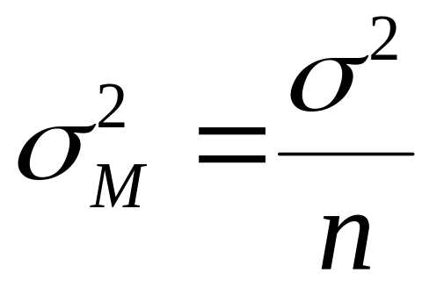
Computing MSB
Notes:
The formula for MSB is based on the fact that the variance of the sampling distribution of the mean is σ2 divided by n, where n is the sample size.
Therefore, if we knew the variance of the sampling distribution of the mean, we could compute σ2 by multiplying by n. Although we do not know the variance of the sampling distribution of the mean, we can estimate it with the variance of the sample means. For the smiles and leniency data, the variance of the four sample means is 0.270. To estimate σ2, we multiply the variance of the sample means (0.270) by n (the number of observations in each group, which is 34). We find that MSB = 9.18.

Slide 26
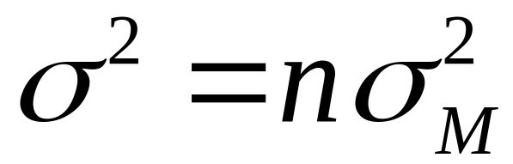
Computing MSB
Notes:
Rearranging this formula we can see that the variance is n times the variance of the sampling distribution of the mean.
Therefore, if we knew the variance of the sampling distribution of the mean, we could compute the variance by multiplying the variance of the sampling distribution of the mean by n. Although we do not know the variance of the sampling distribution of the mean, we can estimate it with the variance of the sample means.

Slide 27
Computing MSB
Variance of sample means = .270
MSB = (34)(.270) = 9.18
Notes:
For the smiles and leniency data, the variance of the four sample means is 0.270. To estimate the population variance, we multiply the variance of the sample means (0.270) by n (the number of observations in each group, which is 34). We find that MSB = 9.18.

Slide 28
Computing MSB Summary
Compute the means.
Compute the variance of the means.
Multiply the variance of the means by n.
Notes:
Here we sum up the steps for computing the MSB with equal sample sizes per condition. First, we compute the mean of each condition. Then, we compute the variance of these means. Finally, we multiply the variance of the means by n

Slide 29
MSE vs. MSB
MSB
  computed from the sample means
  estimates σ² only when the population means are equal
MSE
  computed from the sample variances
  always estimates σ²
Notes:
If the population means are equal, then both MSE and MSB are estimates of the population variance and should therefore be about the same. Naturally, they will not be exactly the same since they are just estimates and are based on different aspects of the data: The MSB is computed from the sample means and the MSE is computed from the sample variances.
If the population means are not equal, then MSE will still estimate the population variance because differences in population means do not affect variances within the groups. However, differences in population means affect the MSB since differences among population means will tend to produce differences among sample means. It follows that the larger the differences among sample means, the larger the MSB. In short, the MSE estimates the population variance whether or not the populations means are equal whereas the MSB estimates the population variance only when the population means are equal and estimates a larger quantity when they are not equal.

Slide 30
Can We Conclude the Population Means are Not Equal?
Need MSB>MSE
But how much larger must MSB be?
Notes:
The critical step in an ANOVA is comparing MSE and MSB. Since MSB estimates a larger quantity than MSE only when the population means are not equal, a finding of a larger MSB than an MSE is a sign that the population means are not equal. But since MSB could be larger than MSE by chance even if the population means are equal, MSB must be much larger than MSE in order to justify the conclusion that the population means differ. But how much larger must MSB be?

Slide 31
Smiles and Leniency F Ratio
F = MSB/MSE
= 9.179/2.649
= 3.465
Notes:
For the Smiles and Leniency data, the MSB and MSE are 9.179 and 2.649 respectively. Is that difference big enough? To answer, we would need to know the probability of getting this big of a difference or a bigger difference if the population means were all equal. The mathematics necessary to answer this question were worked out by the statistician R. Fisher. Although Fisher's original formulation took a slightly different form, the standard method for determining the probability is based on the ratio of MSB to MSE. This ratio is named after Fisher and is called the F ratio.
For these data, the F ratio is 9.179/2.649 = 3.465.
Therefore, the MSB is 3.465 times larger than the MSE.

Slide 32
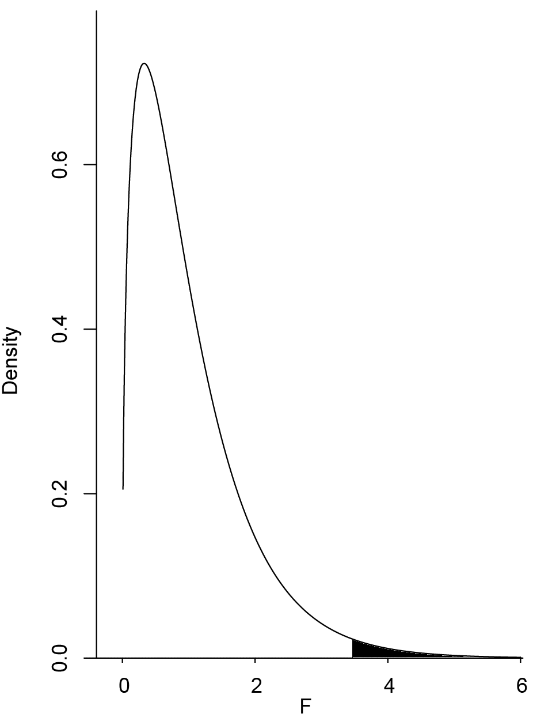
Rejecting the Null Hypothesis
Notes:
Would an F ratio as large as the F of 3.465 that we just calculated have been likely to have happened if all the population means were equal? That depends on the sample size. With a small sample size, it would not be too surprising because small samples are unreliable. However, with a very large sample, the MSB and MSE are almost always about the same, and an F ratio of 3.465 or larger would be very unusual. The figure shows the sampling distribution of F for the sample size in the Smiles and Leniency data. You can see that F ratios of 3.465 or greater are unusual occurrences. The area to the right of 3.465 represents the probability of an F that large or larger and is equal to 0.018. In other words, given the null hypothesis that all the population means are equal, the probability value is 0.018. This p value is below .05, so the null hypothesis can be rejected. Therefore, the conclusion that at least one of the population means is different from at least one of the others is justified.

Slide 33
Degrees of Freedom
df_{numerator} = k – 1
df_{denominator} = k(n -1) = N - k
Notes:
As stated previously, the shape of the F distribution depends on the sample size. More precisely, it depends on two degrees of freedom (df) parameters: one for the numerator (MSB) and one for the denominator (MSE). Recall that the degrees of freedom for an estimate of variance is equal to the number of scores minus one. Since the MSB is the variance of k means, it has k-1 df. The MSE is an average of k variances each with n-1 df. Therefore the df for MSE is k time n-1 which equals Capital N – k where N is the total number of scores, n is the number in each group, and k is the number of groups.

Slide 34
df for Smiles and Leniency Data
df_{numerator} = k - 1= 4 - 1 = 3
df_{denominator} = N - k = 136 - 4 = 132
F = 3.465
p = 0.018
Notes:
For the Smiles and Leniency data,
dfnumerator = k-1 = 4-1 = 3
dfdenominator = N-k = 136-4 = 132
We previously calculated that F = 3.465.
Using the F distribution calculator that can be found in the calculators section, we can find that p = 0.018

Slide 35
One-Tailed or Two?
Notes:
Is the probability value from an F ratio a one-tailed or a two-tailed probability? In the literal sense, it is a one-tailed probability because, as you can see in the figure, the probability is the area in the right-hand tail of the distribution.

Slide 36
One-Tailed or Two?
It tests a two-tailed hypothesis even though the probability is the area in only one tail
Notes:
However, the F ratio is sensitive to any pattern of differences among means. It is therefore a test of a two-tailed hypothesis and is best considered a two-tailed test.

Slide 37
Relationship to the t test
F(1,dfd) = t²(df)
Notes:
Because ANOVA and an independent-groups t test can both test the difference between two means, you might be wondering which one to use. Fortunately, it does not matter since the results will always be the same. When there are only two groups, the following relationship between F and t will always hold:
F(1,dfd) = t²(df)
where dfd is the degrees of freedom for the denominator of the F test and df is the degrees of freedom for the t test. dfd will always equal df.

Slide 38
Sources of Variation
Why do the subjects’ scores differ?
Because of the conditions they were in
Because of error
Notes:
Why do scores in an experiment differ from one another? Consider the scores of two subjects in the Smiles and Leniency study: One from the "False Smile" condition and one from the "Felt Smile" condition. An obvious possible reason that the scores could differ is that the subjects were treated differently (they were in different conditions and saw different stimuli). A second reason is that the two subjects may have differed with regard to their tendency to judge people leniently. A third is that, perhaps, one of the subjects was in a bad mood after receiving a low grade on a test. You can imagine that there are innumerable other reasons why the scores of the two subjects could differ. All of these reasons except the first (that subjects were treated differently) are possibilities that were not under experimental investigation and therefore all differences, or variation, due to these possibilities are unexplained. It is traditional to call unexplained variance error even though there is no implication that an error was made. Therefore, the variation in this experiment can be thought of as being either variation due to the condition the subject was in or due to error (the sum total of all reasons subjects' scores could differ that were not measured).

Slide 39
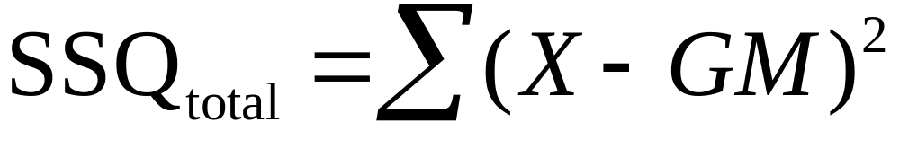
Total Sum of Squares
SSQ_{total} = 377.19
Notes:
One of the important characteristics of ANOVA is that it partitions the variation into its various sources. In ANOVA, the term sums of squares is used to indicate variation. The total variation is defined as the sum of squared differences from the mean of all subjects. The mean of all subjects is called the grand mean and is designated as GM. (When there is an equal number of subjects in each condition, the grand mean is the mean of the condition means.) The formula for the total sum of squares is shown here. This formula says to take each score, subtract the grand mean from it, square the difference, and then sum up these squared values. For the Smiles and Leniency study, SSQtotal = 377.19.

Slide 40
Sum of Squares Condition
= 34[(5.37-4.83)² + (4.91-4.83)² +
(4.91-4.83)² + (4.12-4.83)²] = 27.5
Notes:
The formula for the sum of squares condition is shown here. In this formula, n is the number of scores in each group, k is the number of groups, M1 is the mean for Condition 1, M2 is the mean for Condition 2, and Mk is the mean for Condition k.
For the Smiles and Leniency study, there are 34 subjects in each condition and the grand mean is 4.83. The SSQcondition is calculated as shown and is equal to 27.5

Slide 41
Unequal Sample Sizes
Notes:
If there are unequal sample sizes, use this formula to calculate the sum of squares condition where n sub i is the sample size of the ith condition. SSQtotal is computed the same way shown previously.

Slide 42
Sum of Squares Error
= 349.66
Notes:
The sum of squares error is the sum of the squared deviations of each score from its group mean. Xi1 is the ith score in group 1 and M1 is the mean for group 1, Xi2 is the ith score in group 2 and M2 is the mean for group 2, etc. For the Smiles and Leniency study, the means are: 5.37, 4.91, 4.91, and 4.12. The SSQerror is therefore the sum of the squared deviations of each value in the first condition minus 5.37 plus the sum of the squared deviations of each value in the second condition minus 4.91 plus the sum of the squared deviations of each value in the third condition minus 4.91 plus the sum of the squared deviations of each value in the fourth condition minus 4.12. The sum of squares error for this data is equal to 349.66

Slide 43
Computation by Subtraction
SSQ_{error} = SSQ_{total} - SSQ_{condition}
SSQ_{error} = 377.19 - 27.53 =
349.66
Notes:
The sum of squares error can also be computed by subtraction:
SSQerror = SSQtotal - SSQcondition
So, for the smiles and leniency data, SSQerror = 377.19 - 27.53 = 349.66
Therefore, the total sum of squares of 377.19 can be partitioned into SSQcondition (27.53) and SSQerror (349.66).

Slide 44
Computing the Mean Squares
MSB = SSQ_{condition}/dfn
MSB = 27.5/3 = 9.17
MSE = SSQ_{error}/dfd
dfd = 136 - 4 = 132
MSE = 349.66/132 = 2.65
Notes:
Once the sums of squares have been computed, the mean squares (MSB and MSE) can be computed easily. The formulas are:
MSB = SSQcondition/dfn, where dfn is the degrees of freedom numerator and is equal to k-1.
For the smiles and leniency data, MSB = 27.5/3 = 9.17. Similarly, MSE = SSQerror/dfd, where dfd is the degrees of freedom for the denominator and is equal to N-k. For the smiles and leniency data, there are 136 total subjects and 4 conditions, so dfd = 136 - 4 = 132. Therefore, for these data, MSE = 349.66/132 = 2.65, which is the same value as obtained previously by calculating the mean of the sample variances (except for rounding error). Note that the dfd are often called the dfe for degrees of freedom error.

Slide 45
ANOVA Summary Table
Source | df | SSQ | MS | F | p
Condition | 3 | 27.53 | 9.178 | 3.465 | 0.018
Error | 132 | 349.7 | 2.649
Total | 135 | 377.2
Notes:
The Analysis of Variance Summary Table is a convenient way to summarize the partitioning of the variance.
The first column shows the sources of variation, the second column shows the degrees of freedom, the third shows the sums of squares, the fourth shows the mean squares, the fifth shows the F ratio, and the last shows the probability value. Note that the mean squares are always the sums of squares divided by degrees of freedom. The F and p are relevant only to Condition. Although the mean square total could be computed by dividing the sum of squares total by the degrees of freedom, it is generally not of much interest and is omitted here.

Slide 46
Multiway Anova

Slide 47
Multi-Way ANOVA
Research on two Independent variables
Could do two separate studies
Notes:
In the Bias Against Associates of the Obese case study, the researcher was interested in the effects of two variables possibly affecting ratings of a male job applicant who appeared at an interview with a companion: (1) whether the companion was obese or of typical weight and (2) whether the companion was a girl friend or just an acquaintance. One approach would have been to conduct two separate studies, one investigating the effect of the companions weight and one investigating the effect of the relationship to the companion.

Slide 48
Two-Factor Study
More Efficient
Can Reveal Interaction
Notes:
However, it is more efficient to conduct one study that includes both independent variables. Moreover, there is a much bigger advantage than efficiency of including two variables in the same study: it allows a test of the interaction between the variables. There is an interaction when the effect of one variable differs depending on the level of a second variable. For example, it is possible that the effect of having an obese companion would differ depending on the relationship to the companion. Perhaps there is more prejudice against a person with an obese companion if the companion is a girl friend than if she is just an acquaintance. If so, there would be an interaction between the obesity factor and the relationship factor.

Slide 49
Three Possible Effects
Weight: Is there an effect of weight?
Relationship: Is there an effect of relationship?
Weight x Relationship Interaction: Does the effect of weight differ depending on the relationship with the companion?
Notes:
There are three effects of interest in this experiment:
Weight: Are applicants judged differently depending on the weight of their companion?
Relationship: Are applicants judged differently depending on their relationship with their companion?
Weight x Relationship Interaction: Does the effect of weight differ depending on the relationship with the companion? The first two effects (Weight and Relationship) are both main effects.

Slide 50
Main Effect
A main effect is the effect of a variable averaging over levels of all other variables.
Notes:
A main effect is the effect of a variable averaging over levels of all other variables.

Slide 51
Marginal Means
 | Obese | Typical | Marginal Mean
Girl Friend | 5.65 | 6.19
Acquaintance | 6.15 | 6.59
Marginal Mean
Notes:
It is convenient to talk about main effects in terms of marginal means. The marginal mean for a level of a variable is the mean of the means across all levels of the other variable

Slide 52
Marginal Means
 | Obese | Typical | Marginal Mean
Girl Friend | 5.65 | 6.19
Acquaintance | 6.15 | 6.59
Marginal Mean | 5.90 | 6.39
Notes:
. For example, the marginal mean for the level "Obese" is the average of "Girl-Friend-Obese" and "Acquaintance-Obese." This table shows that this marginal mean is equal to the average of 5.65 and 6.15 which is 5.90. Similarly, the marginal mean for Typical is the average of 6.19 and 6.59 which is 6.39. The main effect of Weight is based on a comparison of the marginal means for obese with the marginal mean for typical.

Slide 53
Marginal Means
 | Obese | Typical | Marginal Mean
Girl Friend | 5.65 | 6.19 | 5.92
Acquaintance | 6.15 | 6.59 | 6.37
Marginal Mean | 5.90 | 6.39
Notes:
Similarly, the marginal means for Girl Friend and Acquaintance are 5.92 and 6.37.

Slide 54
Simple Effects
 | Weight
 | Obese | Typical | Simple Effect
Girl Friend | 5.65 | 6.19
Acquaintance | 6.15 | 6.59
Notes:
In contrast to a main effect which is the effect of a variable averaged across levels of another variable, the simple effect of a variable is the effect of the variable at a single level of another variable

Slide 55
Simple Effects
 | Weight
 | Obese | Typical | Simple Effect
Girl Friend | 5.65 | 6.19 | 0.54
Acquaintance | 6.15 | 6.59
Notes:
The simple effect of "Weight" at the level of "Girl Friend" is the difference between the "Girl-Friend Typical" condition and the "Girl-Friend Obese" conditions. The difference is 6.19-5.65 = 0.54.

Slide 56
Simple Effects
 | Weight
 | Obese | Typical | Simple Effect
Girl Friend | 5.65 | 6.19 | 0.54
Acquaintance | 6.15 | 6.59 | 0.44
Notes:
Similarly, the simple effect of "Weight" at the level of "Acquaintance" is the difference between the "Acquaintance Typical" condition and the "Acquaintance Obese" conditions. The difference is 6.59-6.15 = 0.44.

Slide 57
Interaction: Comparing
Simple Effects
 | Weight
 | Obese | Typical | Simple Effect
Girl Friend | 5.65 | 6.19 | 0.54
Acquaintance | 6.15 | 6.59 | 0.44
Notes:
Recall that there is an interaction when the effect of one variable differs depending on the level of another variable. This is equivalent to saying that there is an interaction when the simple effects differ. In this example, the simple effects are 0.54 and 0.44. As will be shown, these simple effects are not significantly different.

Slide 58
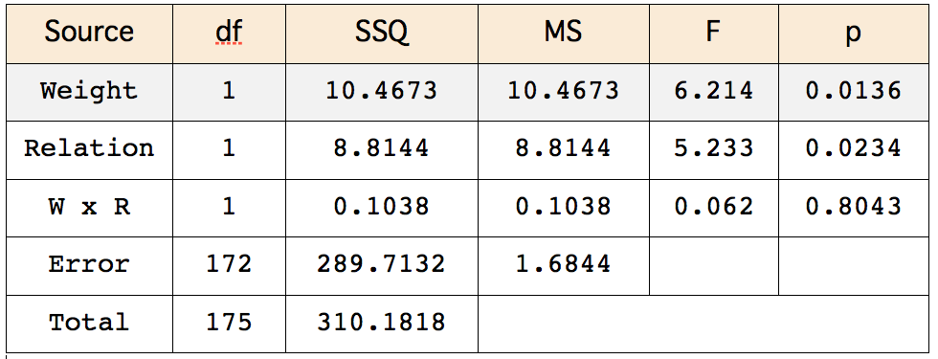
Tests of Significance
Notes:
The important questions are not whether there are main effects and interactions in the sample data. Instead, what is important is what the sample data allow you to conclude about the population. This is where Analysis of Variance comes in. Analysis of Variance tests main effects and interactions for significance. An Analysis of Variance Summary Table for the data is shown here.
Consider first the effect of "Weight." The degrees of freedom (df) for "Weight" is 1. The degrees of freedom for a main effect is always equal to the number of levels of the variable minus one. Since there are two levels of the "Weight" variable (typical and obese) the df is 2 -1 = 1. We will skip the calculation of the sum of squares (SSQ) not because it is difficult, but because it is so much easier to rely on computer programs to compute it. The mean square (MS) is the sum of squares divided by the df.

Slide 59
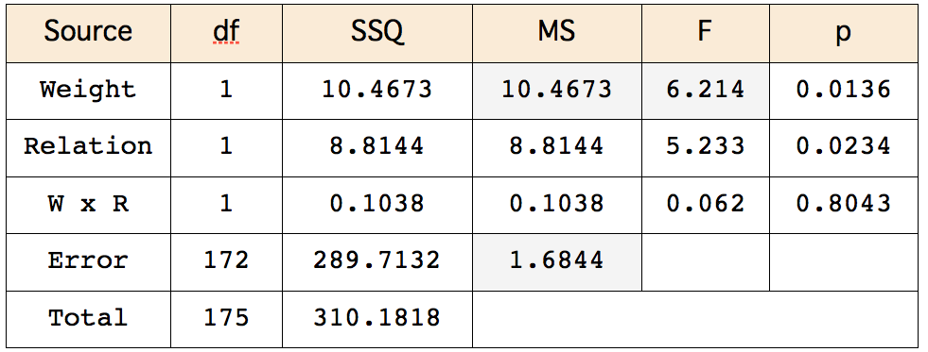
Computing F
Notes:
The F ratio is computed by dividing the mean square (MS) for the effect by the mean square for error . For the effect of "Weight," F = 10.4673/1.6844 = 6.214.

Slide 60
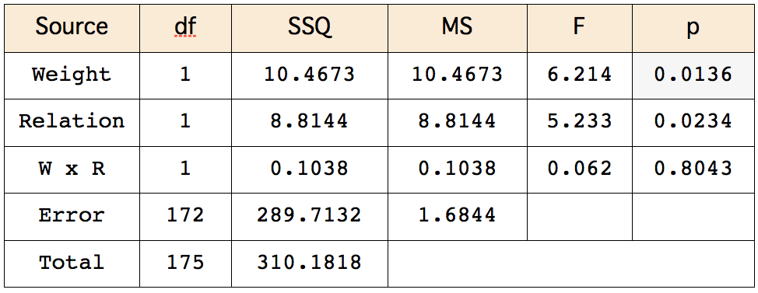
Computing p
Notes:
The last column, p, is is the probability of getting an F of 6.214 or larger given that there is no effect of weight in the population. The F distribution depends on the degrees of freedom for the effect and the degrees of freedom error. The degrees of freedom of an effect is the number of levels of the effect minus one. Here weight has two levels (obese and typical) and therefore the degrees of freedom for weight is 2-1 = 1.
The degrees of freedom error is equal to the total number of observations (176) minus the number of conditions (4 since there are four possible combinations of weight and relation) which equals 172.
The p value for an F with 1 and 172 degrees of freedom is 0.0136 which is quite low and therefore the null hypothesis of no main effect of "Weight" is rejected. The conclusion is that the weight of the companion lowers judgments of qualifications.
The effect "Relation" is interpreted the same way. The conclusion is that being accompanied by a girl friend leads to lower ratings than being accompanied by an acquaintance.

Slide 61
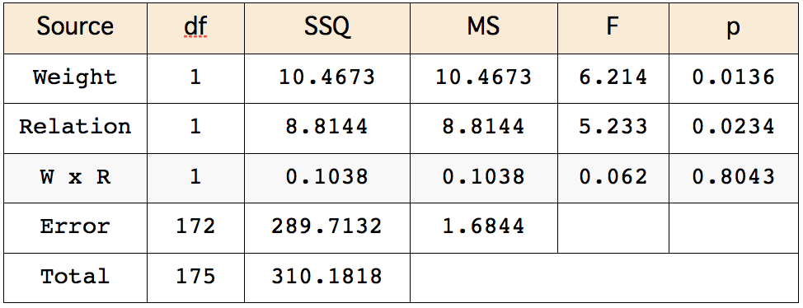
Interaction
Notes:
The degrees of freedom for an interaction is the product of the degrees of freedom of variables in the interaction. For the Weight x Relation interaction (W x R), the degrees of freedom equals 1 since both Weight and Relation have one degrees of freedom : 1 x 1 = 1. The error degrees of freedom are the same for all effects (172), The p value for the interaction’s F of 0.062 with 1 and 172 degrees of freedom is 0.8043. Therefore, these data provide no evidence for an interaction. Always keep in mind that the lack of evidence for an effect does not justify the conclusion that there is no effect. In other words, you do not accept the null hypothesis just because you do not reject it.
When there are equal sample sizes, the sum of squares total will equal the sum all other sums of squares. However, when there are unequal sample sizes, as there are here, this will not generally be true.

Slide 62
Sum of Squares Total
Notes:
When there are equal sample sizes, the sum of squares total will equal the sum all other sums of squares. However, when there are unequal sample sizes, as there are here, this will not generally be true.

Slide 63
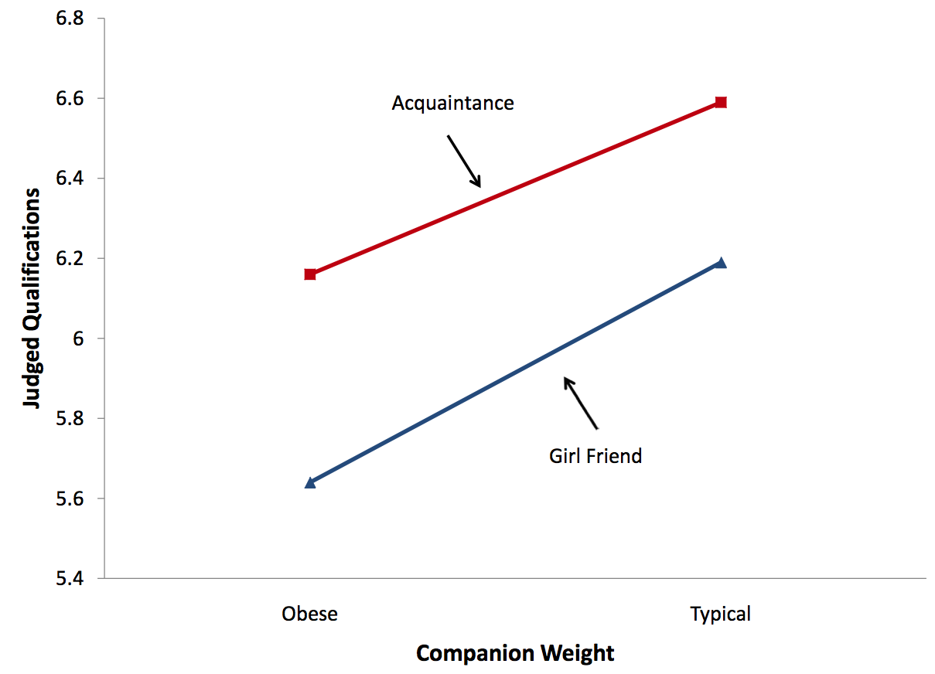
Notes:
The means as a function of weight and relation are shown in this plot. Although this plot illustrates the main effects as well as the interaction (or lack of interaction), it is called an interaction plot. It is important to carefully consider the components of this plot. First, the dependent variable is on the Y axis. Second, one of the independent variables is on the X axis. In this case, it is the variable is "Weight." Finally, a separate line is drawn for each level of the other independent variable.

Slide 64
An Example with Interaction
Self esteem (high and low)
Outcome (success or failure)
Six subjects in each of the four combinations
24 total subjects
Notes:
This example uses data from a hypothetical experiment. Twelve subjects were selected from a population of high-self-esteem subjects and an additional 12 subjects were selected from a population of low-self-esteem subjects. Subjects then performed on a task and (independent of how well they really did) half were told they succeeded and the other half were told they failed . Therefore there were six subjects in each esteem/success combination and 24 subjects altogether.

Slide 65
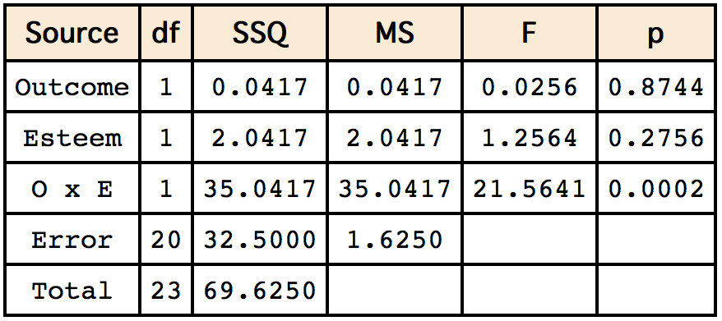
ANOVA Summary Table
Notes:
As you can see, the only significant effect is the Outcome x Esteem (O x E) interaction.

Slide 66
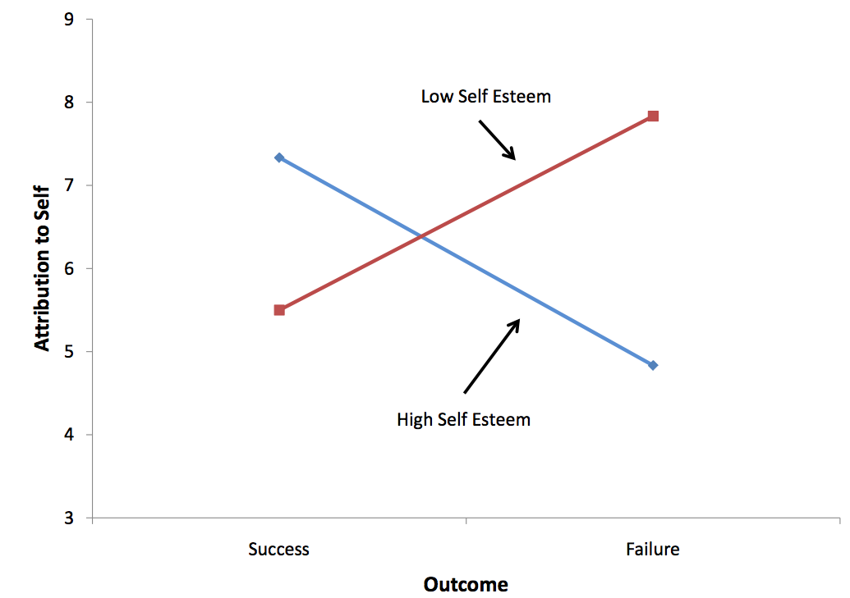
Notes:
Clearly the effect of "Outcome" is different for the two levels of Esteem: For subjects high in self esteem, failure led to less attribution to oneself then did success. By contrast, for subjects low in self esteem, failure led to more attribution to oneself than did success. Notice that the two lines in the graph are not parallel. Nonparallel lines indicate interaction. The significance test for the interaction determines whether it is justified to conclude that the lines in the population are not parallel. Lines do not have to cross for there to be interaction.

Slide 67
Unequal n

Slide 68
Unequal n
Sample Sizes
 |  | Companion Weight
 |  | Obese | Typical
Relation | Girl Friend | 40 | 42
 | Acquaintance | 40 | 54
Notes:
Whether by design, accident, or necessity, the number of subjects in each of the various conditions in an experiment may not be equal. For example, the sample sizes for the Obesity and Relationships case study are shown here. Although the sample sizes were approximately equal, there were more subjects in the Acquaintance/Typical condition than any other. Since n is used to refer to the sample size of an individual group, designs with unequal samples sizes are sometimes referred to as designs with unequal n.

Slide 69
Confounding
Sample Sizes
 |  | Exercise
 |  | Moderate | None
Diet | Low Fat | 5 | 0
 | High Fat | 0 | 5
Notes:
Here we consider an absurd design to illustrate the main problem caused by unequal n. Suppose an experimenter were interested in the effect of diet and exercise on cholesterol. The sample sizes are shown in the table. What makes this example absurd, is that there are no subjects in either the Low Fat/No exercise condition or the High Fat/Moderate exercise condition.

Slide 70
 |  | Exercise
 |  | Moderate | None | Mean
Diet | Low Fat | -20 -25 -30 -35 -15 | 0 | -25
 | High Fat | 0 | -20 6 -10 -6 5 | -5
Mean |  | -25 | -5 | -15
Notes:
The (hypothetical) data showing change in cholesterol are shown here. The last column shows the mean change in cholesterol for the two Diet conditions whereas the last row shows the mean change for the two Exercise conditions. The value of -15 in the lower-right most cell in the table is the mean of all subjects.
We see from the last column that those on the low-fat diet lowered their cholesterol an average of 25 units whereas those on the high-fat diet lowered theirs by only 5 units. However, there is no way of knowing whether the difference is due to diet or to exercise since every subject in the low-fat condition was in the moderate-exercise condition and every subject in the high-fat condition was in the no-exercise condition. Therefore, Diet and Exercise are completely confounded. The problem with unequal n is that it causes confounding.

Slide 71
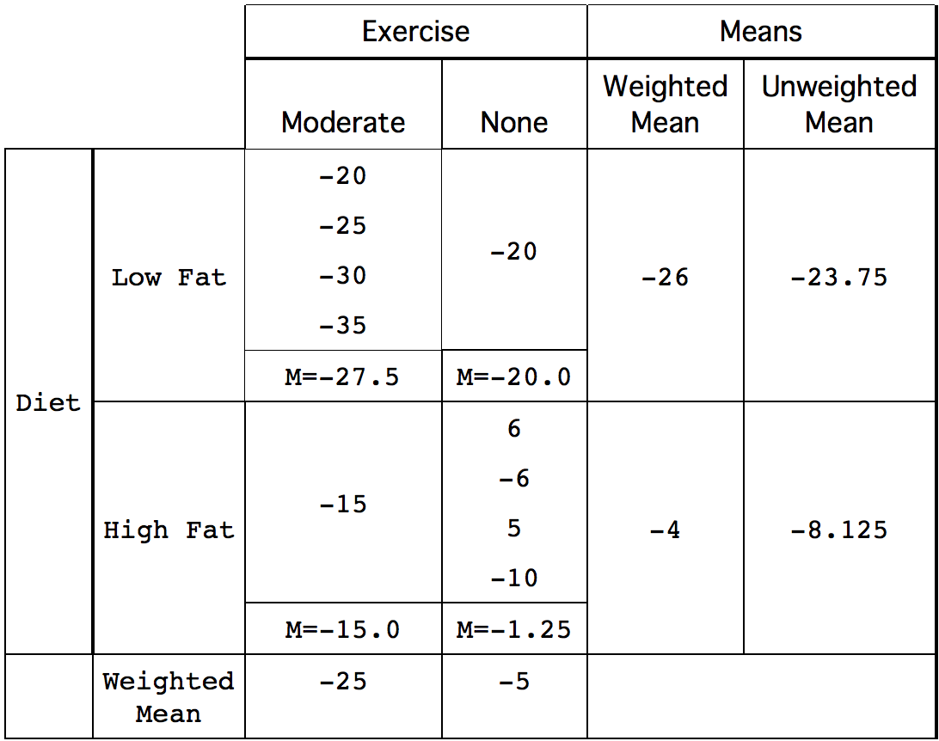
Notes:
Understanding the difference between weighted and unweighted is critical for understanding how to deal with the confounding resulting from unequal n.
We will explain this difference using the data shown here.

Slide 72
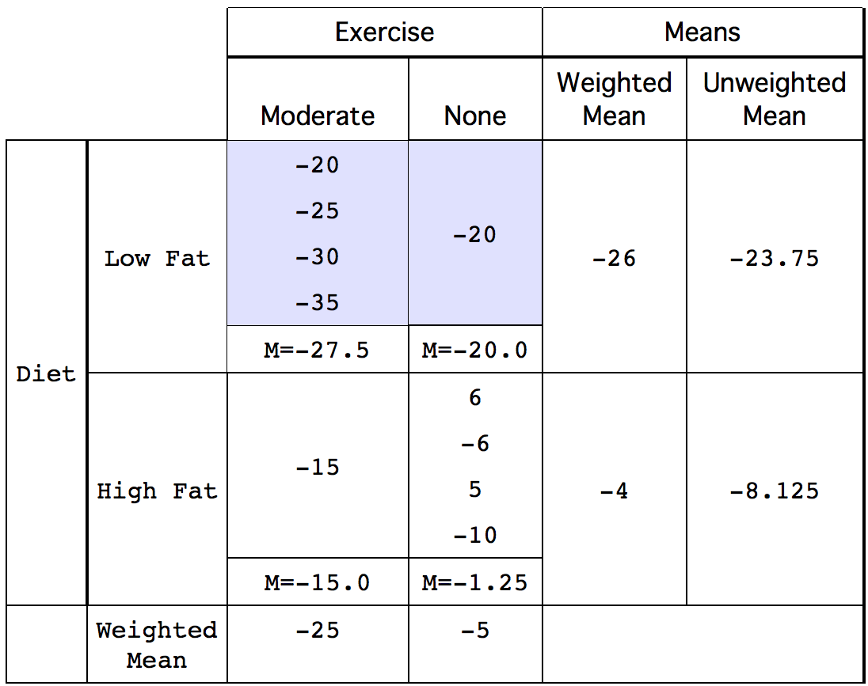
Notes:
In this experiment, Diet and Exercise are confounded because 4 out of 5 subjects in the low-fat condition exercised

Slide 73
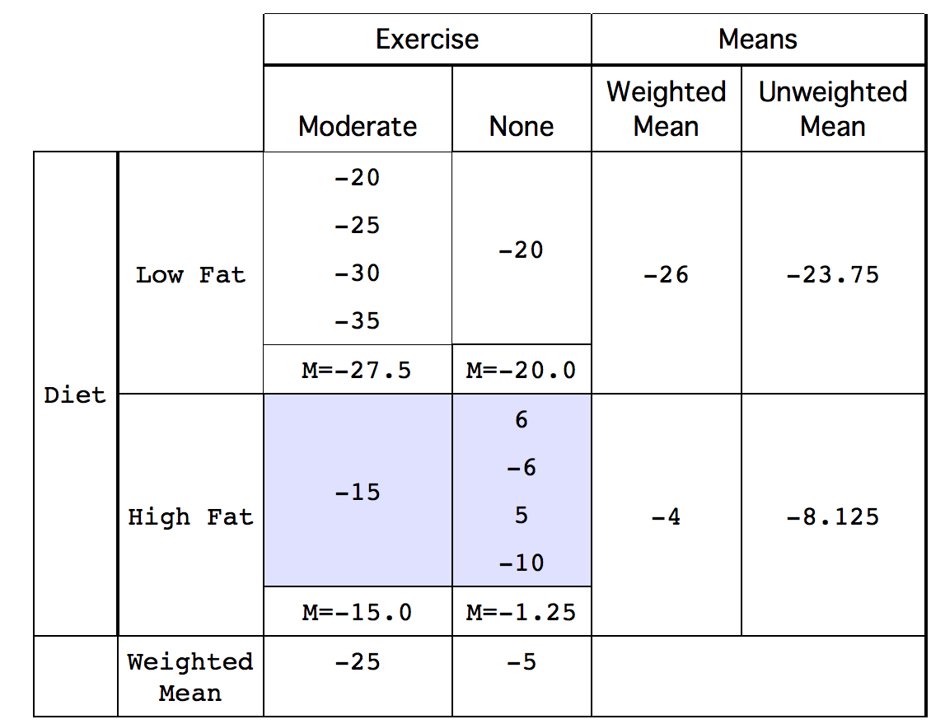
Notes:
as compared to 1 out of 5 in the high-fat condition.

Slide 74
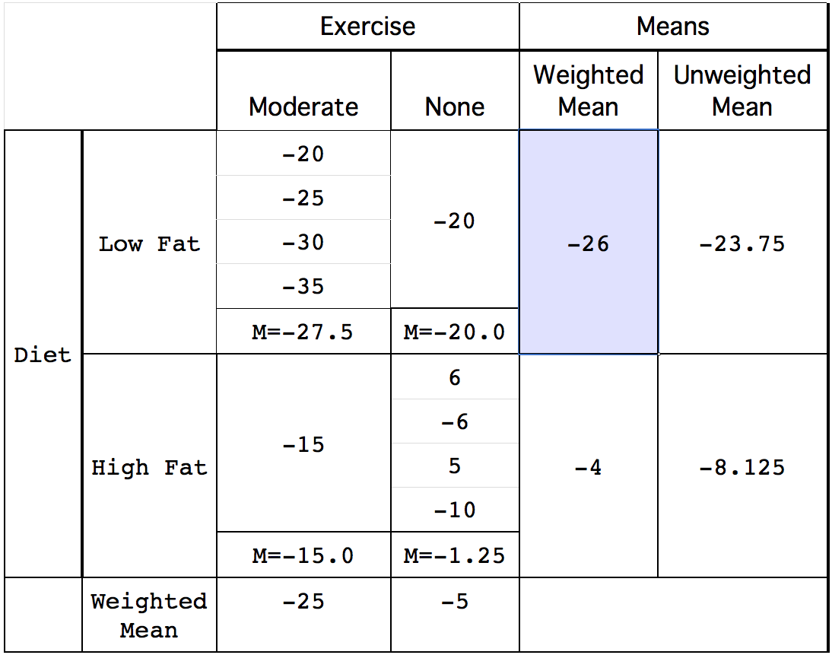
Notes:
The weighted mean for “low fat” is computed as the mean of the low-fat moderate-exercise condition and the low-fat no-exercise mean, weighted in accordance with sample size. To compute a weighted mean, you multiply each mean by its sample size and divide by N, the total number of observations. Since there are four subjects in the low-fat moderate-exercise condition and one subject in the low-fat no-exercise condition, the means are weighted by factors of 4 and 1. Therefore the weighted mean for “low fat” is 4 x -27.5 + 1 x -20 all divided by 5. This equals -26. The weighted mean for the low-fat condition is also the mean of all five scores in this condition. Thus if you ignore the factor "Exercise," you are implicitly computing weighted means.

Slide 75
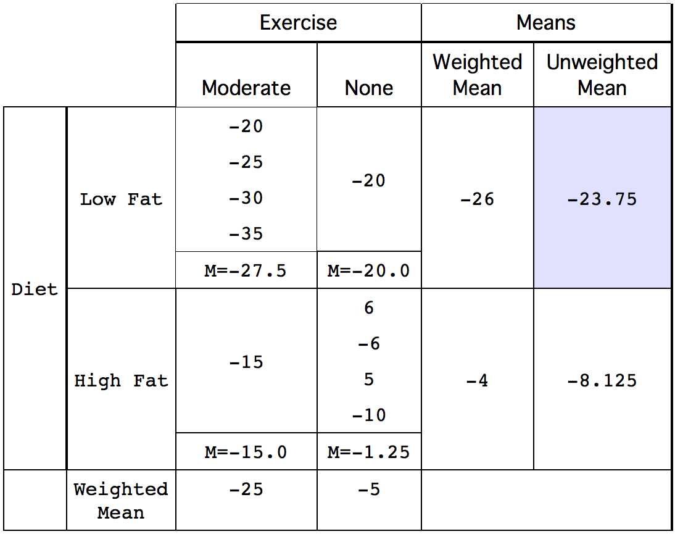
Notes:
The unweighted mean for the low-fat condition is simply the mean of the two means of -27.5 and -20.0. The mean of these numbers is -23.75.

Slide 76
Notes:
One way to evaluate the the main effect of Diet is to compare the weighted mean for the low-fat diet (-26) with the weighted mean for the high-fat diet (-4). This difference of -22 is called "the effect of diet ignoring exercise" and is misleading since most of the low-fat subjects exercised and most of the high-fat subjects did not. However, the difference between the unweighted means of negative 23.75 and negative 8.25 which equals negative 15.5 is not affected by this confounding and is therefore a better measure of the main effect. In short, the weighted means ignore the effects of other variables (exercise in this example) and result in confounding; unweighted means control for the effect of other variables and therefore eliminate the confounding.
Statistical analysis programs use different terms for means that are computed controlling for other effects. SPSS calls them "estimated marginal means" whereas SAS and SAS JMP call them least squares means.

Slide 77
Causes of Unequal n
Subjects assigned randomly to groups
Treatment responsible for differential drop-out rate
Results not interpretable
Notes:
No method for dealing with unequal sample sizes is valid if the experimental treatment is the source of the unequal sample sizes. Imagine an experiment seeking to determine whether publicly performing an embarrassing act would affect one's attitude about public speaking. In this imaginary experiment, the experimental group is asked to reveal to a group of people the most embarrassing thing they have ever done. The control group is asked to describe what they had at their last meal. Twenty subjects are recruited for the experiment and randomly divided into two equal groups of 10, one for the experimental treatment and one for the control. Following the description, subjects are given an attitude survey concerning public speaking. This seems like a valid experimental design. However, of the 10 subjects in the experimental group, four withdrew from the experiment because they did not wish to publicly describe an embarrassing situation. None of the subjects in the control group withdrew. Even if the data analysis shows a significant effect, it would not be valid to conclude that the treatment had an effect because a likely alternative explanation cannot be ruled out. Namely, subjects who were willing to describe an embarrassing situation differed from those who were not even before the experiment began in their attitude toward public speaking. Thus, the differential drop-out rate destroyed the random assignment of subjects to conditions, a critical feature of the experimental design. No amount of statistical adjustment can compensate for this flaw.

Slide 78
Tests Supplementing ANOVA

Slide 79
Supplementing ANOVA
Very general null hypothesis
H₀: μ₁ = μ₂ = … = μ_{k}
Notes:
The null hypothesis tested in a one-factor ANOVA is that all the population means are equal. When the null hypothesis is rejected, then all that can be concluded is that at least one population mean is different from at least one other population mean.

Slide 80
Supplementing Main Effects
Pairwise Comparisons
Specific Comparisons
Notes:
Recall the the main effect of a variable is the effect of that variable averaging over all levels of the other variables. In this section we discuss two types of follow-ups to significant main effects: pairwise comparisons and specific comparisons.

Slide 81
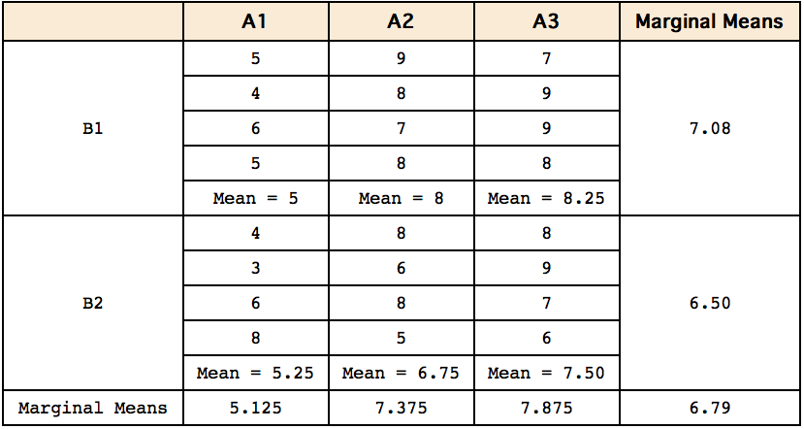
Imaginary Experiment
Notes:
Here we see the data from an imaginary experiment. Notice that the factor A has three levels and the factor B has two levels. In an analysis of variance of these data, the main effect of A is significant reflecting the fact that the marginal means of the three levels of A are quite different.

Slide 82
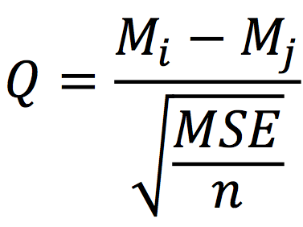
Tukey HSD
M_{i} and M_{j} are marginal means
MSE is the mean square error from the ANOVA
n is the sample size for each group
Notes:
The Tukey honestly significantly difference (HSD) test can be used to test all pairwise comparisons among means in a one-factor ANOVA as well as comparisons among marginal means in a multi-factor ANOVA. The formula for the equal-sample-size case is shown here where Mi and Mj are marginal means, MSE is the mean square error from the ANOVA, and n is the number of scores each mean is based upon.

Slide 83
Probability Value
Degrees of freedom are the dfe from ANOVA
Use Studentized Range Calculator to find p values.
Notes:
The studentized range calculator can find the probability value for a comparison from Q computed in the formula just shown and the degrees of freedom error.

Slide 84
Tukey Test Results
Comparison | M_{i} - M_{j} | Q | p
A₁ - A₂ | -2.25 | -4.68 | 0.0103
A₁ - A₃ | -2.75 | -5.73 | 0.0021
A₂ - A₃ | -0.50 | -1.04 | 0.7456
Notes:
The Tukey tests for the imaginary experiment are shown here. The mean for A1 is significantly lower than the mean for A2 and the mean for A3. The means for A2 and A3 are not significantly different.

Slide 85
Following Interactions
Interactions make interpretations of results more complex
Main Effects do not tell the whole story
Notes:
The presence of a significant interaction makes the interpretation of the results more complicated. Since an interaction means that the simple effects are different, the main effect as the mean of the simple effects does not tell the whole story. What follows is a discussion of how to describe interactions and proper and improper uses of simple effects tests.

Slide 86
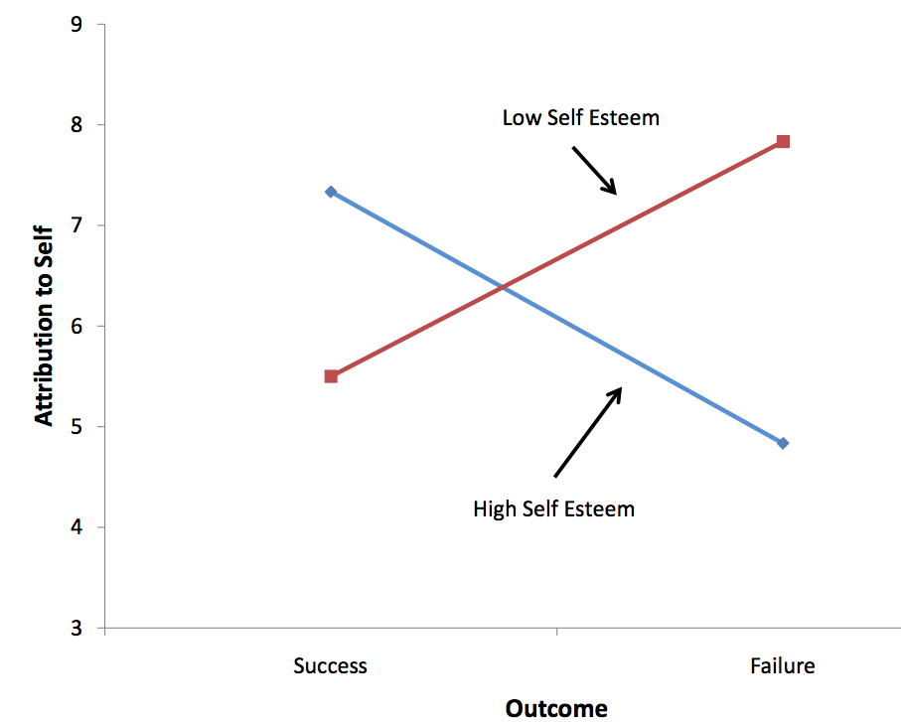
Notes:
A crucial step first step in understanding am interaction is constructing an interaction plot. The plot shown here is for an interaction of the variables “Outcome” and “Self Esteem.” The second step is to describe the interaction in a clear and understandable way. This is often done by describing how by describing how the simple effects differ. Since this should be done using as little jargon as possible, the term "simple effect" need not appear in the description. Here is an example: “The difference between the attributions to self following success and attributions to self following failure was larger for high-self-esteem subjects (mean difference = 2.50) than for low-self-esteem subjects (mean difference = -2.33).” No further analyses are helpful in understanding the interaction since the interaction means only that the simple effects differ. The interaction's significance indicates that the simple effects differ from each other, but provides no information about whether they differ from zero.

Slide 87
Simple Effect tests
Not used to understand interaction
Interaction means main effects are not general
Notes:
It is not necessary to know whether the simple effects differ from zero in order to understand an interaction because the question of whether simple effects differ from zero has nothing to do with interaction except that if they are both zero there is no interaction. It is not uncommon to see research articles in which the authors report that they analyzed simple effects in order to explain the interaction. However, this is not a correct since an interaction does not depend on the analysis of the simple effects.However, there is a reason to test simple effects following a significant interaction. Since an interaction indicates that simple effects differ, it means that the main effects are not general. In the example with outcome and self esteem, the main effect of Outcome is not very informative, and the effect of outcome should be considered separately for high- and low-self-esteem subjects.

Slide 88
Neither Simple Effect is Significant
Simple effects differ
At least one is not 0
Cannot determine which one(s)
Notes:
Suppose an interaction is significant but no simple effect is significant. The conclusion should be that the simple effects differ and that that at least one of them is not zero. However, no conclusion should be drawn about which simple effect(s) is or are not zero.

Slide 89
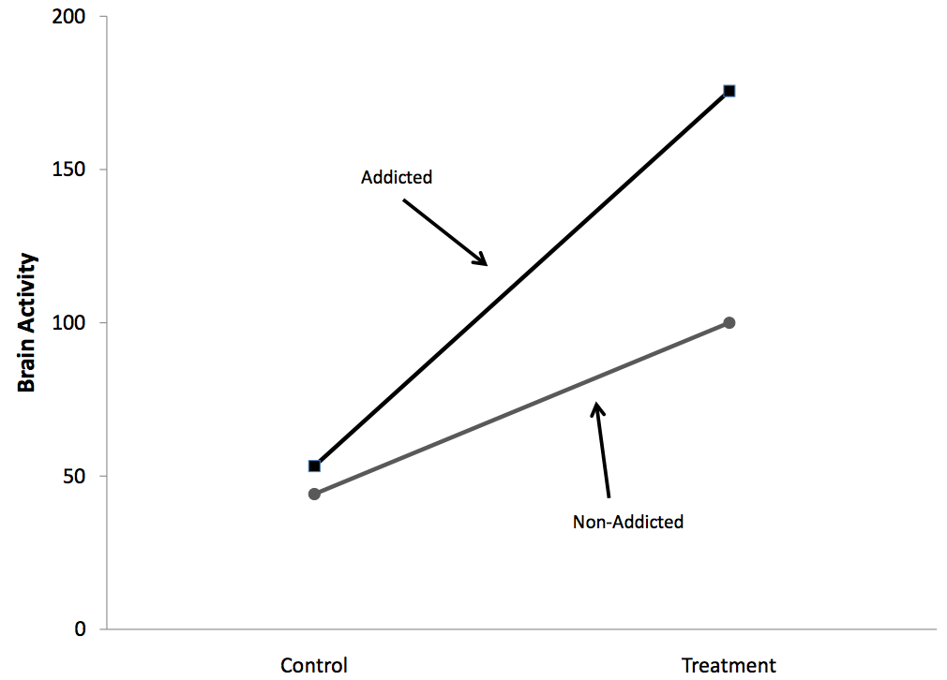
Common Misinterpretation
Notes:
A common error is to conclude that two simple effects are different because one is significant and the other is not. Consider the results of a hypothetical experiment in which the researcher hypothesized that addicted people would show a larger increase in brain activity following some treatment than would non-addicted people. In other words, the researcher hypothesized that addiction status and treatment would interact. The results shown here are very much in line with the hypothesis. However, the test of the interaction resulted in a probability value of 0.08, a value not quite low enough to be significant at the conventional 0.05 level. The proper conclusion is that the experiment supports the researcher's hypothesis, but not strongly enough to allow a firm conclusion.
Unfortunately, the researcher was not satisfied with such a weak conclusion and went on to test the simple effects. It turned out that the effect of Treatment was significant for the Addicted group (p = 0.02) but not significant for the Non-Addicted group (p = 0.09). The researcher then went on to conclude that since there is an effect of Treatment for the Addicted group but not for the Non-Addicted group, the hypothesis of a greater effect for the former than for the latter group is demonstrated. This is faulty logic, however, since it is based on accepting the null hypothesis that the simple effect of Treatment is zero for the Non-Addicted group just because it is not significant.

Slide 90
Within Subjects ANOVA

Slide 91
Within-Subjects Anova
Comparisons of same subjects under different conditions
Each subject serves as his or her own control
Within subjects designs are usually more powerful than between-subjects designs
Notes:
Within-subjects factors involve comparisons of the same subjects under different conditions. For example, in the ADHD Treatment Study, each child's performance was measured four times, once after being on each of four drug doses for a week. Therefore, each subject's performance was measured at each of the four levels of the factor "Dose." Note the difference from between-subjects factors for which each subject's performance is measured only once and the comparisons are among different groups of subjects. A within-subjects factor is sometimes referred to as a repeated measures factor since repeated measurements are taken on each subject. An experimental design in which the independent variable is a within-subjects factor is called a within-subjects design. An advantage of within-subjects designs is that individual differences in subjects' overall levels of performance are controlled. This is important because subjects invariably will differ from one another. In an experiment on problem solving, some subjects will be better than others regardless of the condition they are in. Similarly, in a study of blood pressure some subjects will have higher blood pressure than others regardless of the condition. Within-subjects designs control these individual differences by comparing the scores of a subject in one condition to the scores of the same subject in other conditions. In this sense each subject serves as his or her own control. This typically gives within-subjects designs considerably more power than between-subjects designs.

Slide 92
ADHD Study
24 children tested under four dosage levels
Consider only the lowest lowest and highest dosage here
Calculations done by computers
Notes:
Let's consider how to analyze the data from the ADHD treatment case study. These data consist of the scores of 24 children with ADHD on a delay of gratification task. Each child was tested under four dosage levels. For now we will be concerned only with testing the difference between the mean in the placebo condition (the lowest dosage, D0) and the mean in the highest dosage condition (D60). The details of the computations are relatively unimportant since they are almost universally done by computers.

Slide 93
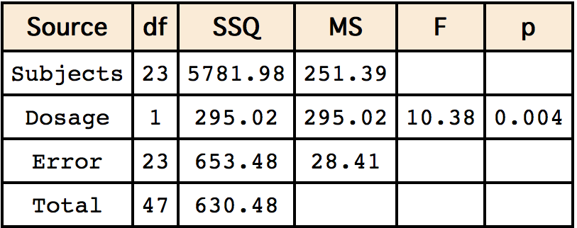
ANOVA Summary Table
Notes:
Therefore we jump right to the ANOVA Summary table shown here.
The first source of variation, "Subjects," refers to the differences among subjects. If all the subjects had exactly the same mean (across the two dosages) then the sum of squares for subjects would be zero; the more subjects differ from each other, the larger the sum of squares subjects. Dosage refers to the differences between the two dosage levels. If the means for the two dosage levels were equal, the sum of squares would be zero. The larger the difference between means, the larger the sum of squares.
The error reflects the degree to which the effect of dosage is different for different subjects. If subjects responded very similarly to the drug, then the error would be very low. For example, if all subjects performed moderately better with the high dose than they did with the placebo, then the error would be low. On the other hand, if some subjects did better with the placebo while others did better with the high dose, then the error would be high. It should make intuitive sense that the less consistent the effect of the drug, the larger the drug effect would have to be in order to be significant. The degree to which the effect of the drug differs depending on the subject is the Subjects x Drug interaction. Recall that an interaction occurs when the effect of one variable differs depending on the level of another variable. In this case, the size of the error term is the extent to which the effect of the variable "Drug" differs depending on the level of the variable "Subjects." Note that each subject is a different level of the variable "Subjects.”
Other portions of the summary table have the same meaning as in between-subjects ANOVA. The F for dosage is the mean square for dosage divided by the mean square error. For these data, the F is significant with p = 0.004.

Slide 94
F an t
p value the same as with correlated t test
F = t²
Notes:
Note that probability value for this F test is equivalent to the probability value for a t-test for correlated pairs, with F = t².

Slide 95
All Four Dosage Levels
df for dosage = 4 – 1 = 3
df for Subjects = 24 -1 = 23
df for error = 23 x 3 = 69
Notes:
Now consider the analysis when all four doses are included. With four dosage levels, the degrees for freedom for dosage is three. Since the error is the Subjects x Dosage interaction, the degrees for freedom for error is the degrees for freedom for "Subjects" (23) times the degrees for freedom for Dosage (3) and is equal to 69.

Slide 96
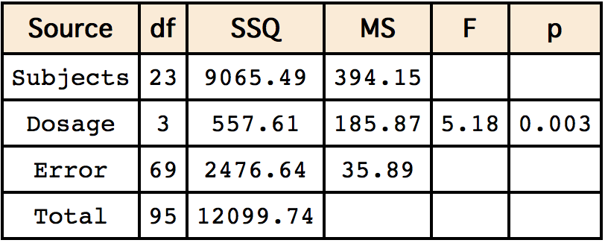
ANOVA Summary Table
Notes:
Here is the ANOVA Summary Table when all four doses are included in the analysis. The effect of dosage is significant, p = 0.003.

Slide 97
Designs with Between- and Within-Subjects Variables
Two genders (between subjects)
Three tasks (within subjects)
Notes:
In the Stroop Interference case study, subjects performed three tasks: naming colors, reading color words, and naming the ink color of color words. Some of the subjects were males and some of the subjects were females. Therefore this design had two factors: gender and task. Gender is a between-subjects variable since the male subjects were not the same subjects as the female subjects. Tasks is a within-subject variable because each subject performed all three tasks.

Slide 98
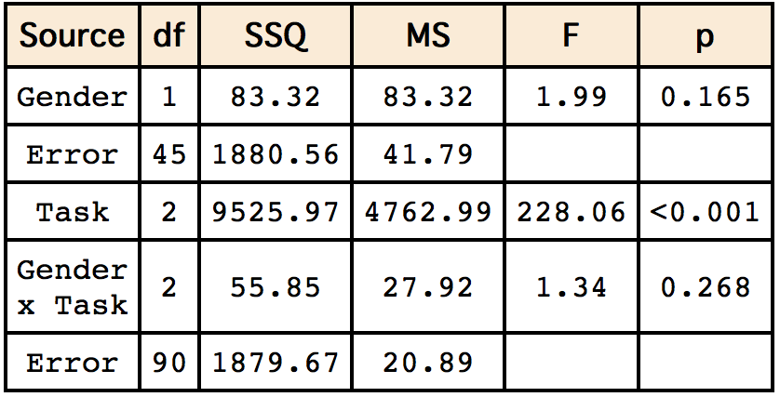
ANOVA Summary Table
Notes:
The ANOVA Summary Table for this design is shown here.
The computations for the sum of squares will not be covered since computations are normally done by software. However, there are some important things to learn from the summary table. First notice that there are two error terms: one for the between-subjects variable Gender and one that is used for both the within-subjects variable Task and the interaction of the between-subjects variable and the within-subjects variable. Typically, the mean square error for the between-subjects variable will be higher than the other mean square error. In this example, the mean square error for Gender is about twice as large as the other mean square error.
The degrees of freedom for the between-subjects variable is equal to the number of levels of the between subjects variable minus one. In this example it is one since there are two levels of gender. Similarly, the degrees of freedom for the within-subjects variable is equal to the number of levels of the variable minus one. In this example, it is two since there are three tasks. The degrees of freedom for the interaction is the product of the degrees of freedom Gender (which is 1) and the degrees of freedom Task (which is 2) and is equal to 2.

Slide 99
Assumption of Sphericity
Correlations among variables are equal
Variances of variables are equal
Notes:
Within-subjects ANOVA makes a restrictive assumption about the variances and the correlations among the dependent variables. Although the details of the assumption are beyond the scope of this book, it is approximately correct to say that it is assumed that all the correlations among variables are equal and all the variances are equal. The table shows the correlations among the three dependent variables in the Stroop Interference case study.
Note that the correlation between the word reading and the color naming variables of 0.7013 is much higher than the correlation between either of these variables with the interference variable. Moreover, as shown in the Table , the variances among the variables differ greatly.
Naturally, the assumption of sphericity, like all assumptions, refers to populations not samples. However it is clear from these sample data, the assumption is not met here in the population.

Slide 100
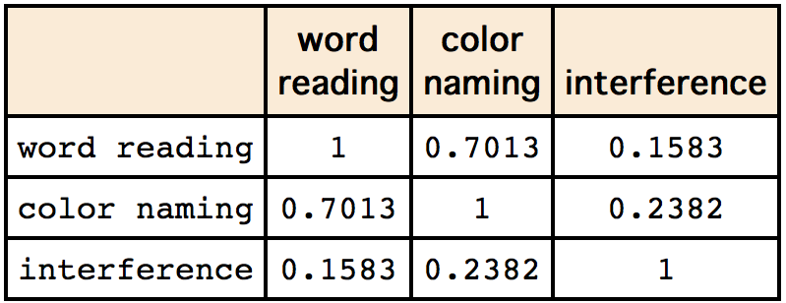
Assumption of Sphericity
Notes:
This table shows the correlations among the three dependent variables in the Stroop Interference case study.
Note that the correlation between the word reading and the color naming variables of 0.7013 is much higher than the correlation between either of these variables with the interference variable. Moreover, as shown in the Table , the variances among the variables differ greatly.

Slide 101
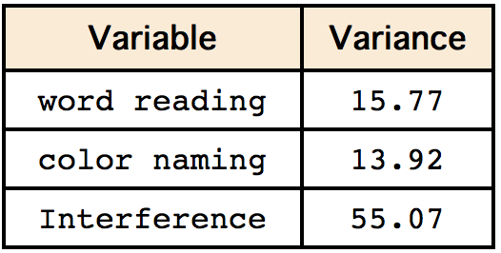
Assumption of Sphericity
Notes:
Moreover, as shown here, the variances among the variables differ greatly.
Naturally, the assumption of sphericity, like all assumptions, refers to populations not samples. However it is clear from these sample data, the assumption is not met in the population.

Slide 102
Violating the Sphericity Assumption
Increases Type I error rate
Some software reports corrects called “Huynh-Feldt” and/or Geisser Greenhouse
Multivariate Method
Notes:
Although ANOVA is robust to most violations of its assumptions, the assumption of sphericity is an exception: Violating the assumption of sphericity leads to a substantial increase in the Type I error rate. Moreover, this assumption is rarely met in practice. Although violations of this assumption had at one time received little attention, the current consensus of data analysts is that it is no longer considered acceptable to ignore them.
A correction is to multiply the degrees of freedom by a quantity called epsilon. There are two commonly-used methods of calculating epsilon. The correction called the Huynh-Feldt (or H-F) is slightly preferred to the one now conventionally called the Geisser Greenhouse (or G-G) although both work well. The G-G correction is generally considered a little too conservative. The calculation of these corrections is complex, and best left to computer software.
A final method for dealing with violations of sphericity is to use a multivariate approach to within-subjects variables. This method has much to recommend it, but is beyond the score of this text.

Slide 103

Carry Over Effects
Spoiling the surprise
Some are not so serious
Asymmetric carry-over
effects are more serious
Notes:
Often performing in one condition affects performance in a subsequent condition in such a way to make a within-subjects design impractical. For example, consider an experiment with two conditions. In both condition subjects are presented with pairs of words. In Condition A subjects are asked to judge whether the words have similar meaning; in Condition B subjects are asked to judged whether they sound similar. In both conditions, subjects are given a surprise memory test at the end of the presentation. In both conditions, subjects are given a surprise memory test at the end of the presentation. If condition were a within-subjects variable, then there would be no surprise after the second presentation and it is likely that the subjects would have been trying to memorize the words.
Not all carry-over effects cause such serious problems. For example, if subjects get fatigued by performing a task, then they would be expected to do worse on the second condition they were in. However, as long as half the subjects are in Condition A first and Condition B second, the fatigue effect itself would not invalidate the results, although it would add noise and reduce power. The carryover effect is symmetric in that having Condition A first affects performance in Condition B to the same degree that having Condition B first affects performance in Condition A. Asymmetric carryover effects cause more serious problems. For example, suppose performance in Condition B were much better if preceded by Condition A whereas performance in Condition A was approximately the same regardless of whether it was preceded by Condition B. When this kind of carryover effect is possible, it is probably better to use a between-subjects design.

Slide 104
EFFECT SIZE

Slide 105
Effect Size Introduction
It is often important to learn more than just whether an effect is not 0 or determine the direction of the effect
Notes:
Researchers often seek to learn more than whether the variable under investigation has an effect and/or determine the direction of the effect. This is particularly true for research that has practical applications. For example, an investigation of the efficacy of a pain-relief drug would seek to determine the extent of the relief and not merely whether there was any relief. Similarly, an investigation of the relationship between exercise and blood pressure would seek to determine how much blood pressure decreases for a given amount of exercise. In both of these examples, a significance test would not be sufficient since it would only provide the researcher information about the existence and direction of the effect. It would not provide any information about the size of the effect.

Slide 106
Effect Size Introduction
It is often important to learn more than just whether an effect is not 0 or determine the direction of the effect
On the other hand, sometimes demonstrating the existence of an effect is theoretically important
Notes:
Before we proceed with a discussion of how to measure effect size, it is important to consider that for some research it is the presence/absence of an effect rather than its size that is important. For example, Eddington in 1919 conducted a critical test of one of the key tenets of Einstein's general theory of relativity: gravity bends light. Since the alternative theory (Newton's) held that there should be no effect of gravity on light, it was the presence/absence of the effect rather than its possible size that was critical. Measurements taken during a total eclipse of the sun on May 29, 1919 supported Einstein's theory that gravity bends light and contradicted the long-held views of Newton. Thus, it was evidence of the existence of an effect rather than the estimation of its size that was important in this classic experiment.

Slide 107
PROPORTIONS

Slide 108
Proportions
Absolute Risk Reduction
Relative Risk Reduction
Odds Ratio
Number Needed to Treat
Notes:
Here we consider the analysis of proportions in the case study "Mediterranean Diet and Health." In this study, one group of people followed the diet recommended by the American Heart Association (AHA) whereas a second group followed the "Mediterranean Diet." One interesting comparison is between the proportion of people who were healthy throughout the study as a function of diet. It turned out that 0.79 of the people who followed the AHA diet and .90 of those followed the Mediterranean diet were healthy. How is the effect size of diet best measured?

Slide 109
Absolute Risk Reduction (ARR)
Difference in proportions
Not healthy on AHA: 0.21
Not healthy on Mediterranean: 0.10
Difference: 0.11
Notes:
We will take the perspective that we are assessing the benefit of switching from the AHA diet to the Mediterranean diet. One way to assess the benefit is to compute the difference between the proportion who were not healthy on AHA diet (0.21) with the proportion who were not healthy on the Mediterranean diet (0.10). The difference in proportions is: 0.21 - 0.10 = 0.11.This measure of the benefit is called the Absolute Risk Reduction (ARR).

Slide 110
Relative Risk Reduction
Compute the proportion reduction
Reduction from .21 to .10 is a 53% reduction: (.21 - .10)/.21 x 100 = 53
RRR = (C - T)/C x 100
C is the proportion not healthy in the control group; T is the proportion not healthy in the Treatment group
Notes:
Alternatively, one could measure the difference in terms of percentages. For our example, the proportion of non-healthy people on the Mediterranean diet (0.10) is 53% lower than the proportion non-healthy people on the AHA diet (0.21). This value is computed as: The quantity 0.21 minus 0.10 divided by 0.21 multiplied by 100 and is equal to 53%. This measure of the benefit is called the Relative Risk Reduction (RRR). The general formula for RRR is: RRR = the quantity C – T divided by C times 100 where C is the proportion not healthy in the control group and T is the proportion not healthy in the Treatment group

Slide 111
Odd Ratio
The odds of being healthy on the Mediterranean diet are 90:10 = 9:1
The odds of being healthy on the AHA diet are 79:21 = 3.76:1
Odds ratio = 9/3.76 = 2.39
Notes:
A third measure commonly used measure is the "odds ratio." For our example, the odds of being healthy on the Mediterranean diet are 90:10 = 9:1. The ratio of these two odds is 9/3.76 = 2.39. Therefore the odds of being healthy on the Mediterranean diet is 2.39 times the odds of being healthy on the AHA diet. Note that the odds ratio is the ratio of the odds and not the ratio of the probabilities.

Slide 112
Number Needed to Treat
Treatment defined as changing from AHA to Medierranean diet
N = 1/ARR
N = 1/.11 = 9
One person stays healthy who otherwise would not be healthy for every 9 who switch
Notes:
A fourth measure is the number of people who need to be treated in order to prevent one person from having the ailment of interest. In our example, being treated means changing from the AHA diet to the Mediterranean diet. The number who need to be treated can be defined as N = 1/ARR
For our example,
N = 1/0.11 = 9
Therefore, one person who would otherwise not be healthy would be expected to stay healthy for every nine people changing from the AHA diet to the Mediterranean diet.

Slide 113
Which Measure to Use?
All have their proper uses
RRR can exaggerate the importance of an effect
Reduce risk from 1 in 1,000,000 to 1 in 2,000,000
RRR is 50% even though the practical risk is minimal
Notes:
he obvious question is which of these measures is the best. Although each measure has its proper uses, the RRR reduction can exaggerate the importance of an effect, especially when the absolute risks are low. For example, if a drug reduced the risk of a certain disease from 1 in 1,000,000 to 1 in 2,000,000 the RRR is 50%. However, since the ARR from 1 in 2 million to 1 in 1 million is small, the practical reduction in risk is minimal.

Slide 114
TWO MEANS

Slide 115
Difference Between Means
Scale is meaningful
Standardized measures
Interpretational issues
Notes:
In this section we will discuss measures of the size of the difference between means. We begin with the case in which the dependent variable is measured on a scale that is intrinsically meaningful. We then discuss measures when the scale is not intrinsically meaningful and the use of standardized measures for these measures. Finally we discuss some interpretational issues in measuring effect size.

Slide 116
Intrinsically Meaningful Measures
Simple difference
Notes:
When the units of a measurement scale are meaningful in their own right, then the difference between means is often a good and easily interpretable measure of effect size. For example, a study by Holbrook, Crowther, Lotter, Cheng and Kingon conducted in 2000 investigated the effectiveness of benzodiazepine for the treatment of insomnia. These researchers found that, compared to a placebo, this drug increased total sleep duration by a mean of 61.8 minutes. This difference in means shows clearly the degree to which benzodiazepine is effective. (It is important to note that the drug was found to sometimes have adverse side effects.)

Slide 117
Intrinsically Meaningful Measures
Simple difference
Proportional difference
  If placebo mean were 120 minutes then 61.8 minutes is a 51% increase
  If placebo mean were 420 minutes then the increase is a 15% increase
Notes:
When the dependent variable is measured on a ratio scale then it is often informative to consider the proportional difference between means in addition to the absolute difference. For example, if in the Holbrook et al. study the mean total sleep time for the placebo group was 120 minutes, then the 61.8 minute increase would represent a 51% increase in sleep time. On the other hand, if the mean sleep time for the placebo were 420 minutes then the 61.8 minute increase would represent a 15% increase in sleep time.

Slide 118
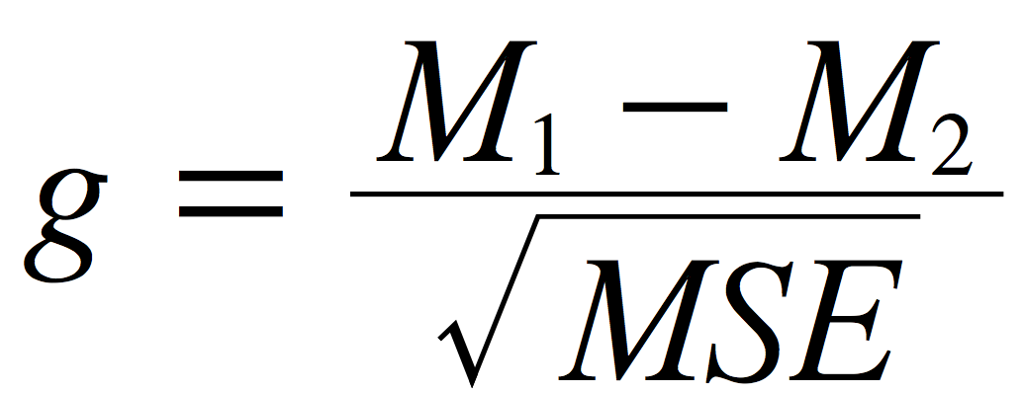
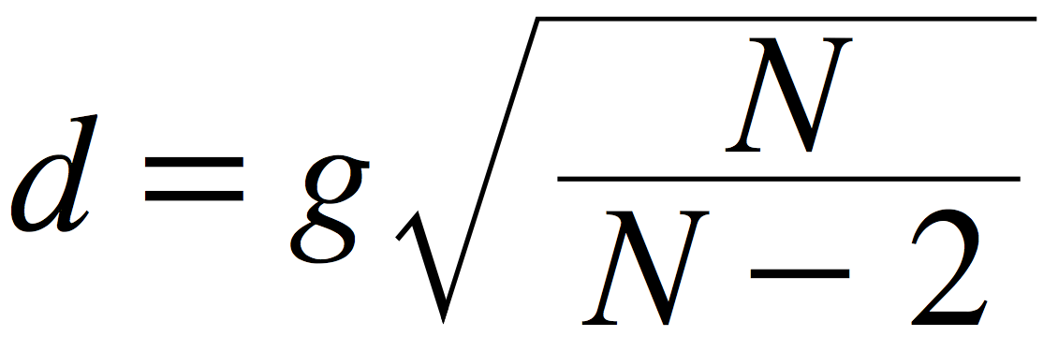
Standardized Differences
Used when the scale is not inherently meaningful
Hedges’s g
Cohen’s d
Notes:
When the scale of a dependent variable is not inherently meaningful, It is common to consider the difference between means in standardized units. That is, effect size is measured in terms of how the number of standard deviations the means differ by. Two commonly used measures are Hedges's g and Cohen's d. Both of these measures consist of the difference between means divided by the standard deviation. They differ only in that Hedges's g uses the version of the standard deviation formula in which you divide by N-1 whereas Cohen's d uses the version in which you divide by N.

Slide 119
Scale Free
Standardized measures are scale free
Animal Research Case Study
  Mean difference on a 7-point scale was 1.47
  Standardized difference was 0.87
Notes:
Standardized measures such as Cohen's d and Hedges's d have the advantage that they are scale free. That is, since the dependent variable is standardized, the original units are replaced by standardized units and are interpretable even if the original scale units do not have clear meaning. Consider the Animal Research case study. The mean for women was 5.353, the mean for men was 3.882, and MSE was 2.864. Therefore, Hedges g is 0.87. It is more meaningful to say that the means were 0.87 standard deviations apart than 1.47 scale units apart since the scale units are not well defined.

Slide 120
What is a Large Effect?
Cohen’s guidelines
  0.2: small
  0.5: medium
  0.8: large
Not universally accepted
Notes:
It is natural to ask what constitutes a large effect. Although there is no objective answer to this question, the guidelines suggested by Cohen in 1988 that an effect size of 0.2 is a small effect, an effect size of 0.5 is medium effect, and an effect size of 0.8 is large effect has been widely adopted. Based on these guidelines, the effect size of 0.87 is a large effect. It should be noted, however, that these guidelines are somewhat arbitrary and have not been universally accepted.

Slide 121
Interpretational Issues
Interest in extreme values
Selecting students into a highly-selective program
  Means 50 & 52; SD = 10
  Difference is 0.2 SD’s (a small difference)
Students scoring 70 or higher qualify
Ratio of red to blue students: 1.6:1.
Notes:
It is important to realize that the importance of an effect depends on the context. For example, a small effect can make a big difference if only extreme observations are of interest. Consider a situation in which a test is used to select students for a highly-selective program. Assume that there are two types of students (red and blue) and the mean for the red students is 52, the mean for blue students is 50, both distributions are normal, and the standard deviation for each distribution is 10. The difference in means is therefore only 0.2 standard deviations and would generally be considered to be a small difference. Now assume that only students who scored 70 or higher would be selected for the program. Would there be a big difference between the proportion of blue and red students who would be able to be accepted into the program? It turns out that the proportion of red students who would qualify is 0.036 and the proportion of blue students is 0.023. Although this difference is small in absolute terms, the ratio of red to blue students who qualify is 1.6:1. This means that if 100 students were to be accepted and if equal numbers of randomly-selected red and blue students applied, 62% would be red and 38% would be blue. In most contexts this would be considered an important difference.

Slide 122
Interpretational Issues
More homogeneous subjects results in larger standardized measure
Two Experiments both decrease blood pressure by 10
SD = 20 in Exp 1; 30 in Exp 2
Standardized measures: 0.50 and 0.33
Notes:
When the effect size is measured in standard deviation units as it is for Hedges's g and Cohen's d, it is important to recognize that the variability in the subjects has a large influence on the effect size measure. Therefore, if two experiments both compared the same treatment to a control but the subjects were much more homogeneous in Experiment 1 than in Experiment 2, then a standardized effect size measure would be much larger in the former experiment than in the latter. Consider two hypothetical experiments on the effect of an exercise program on blood pressure. Assume that the mean effect on systolic blood pressure of the program is 10 and that due to differences in the subject populations sampled in the two experiments, the standard deviation was 20 in Experiment 1 and 30 in Experiment 2. Under these conditions, the standardized measure of effect size would be 0.50 in Experiment 1 and 0.33 in Experiment 2. This standardized difference in effect size occurs even though the effectiveness of the treatment is exactly the same in the two experiments.

Slide 123
VARIANCE EXPLAINED

Slide 124
Overview
Analysis of Variance (ANOVA)Designs
Correlational Designs
Notes:
Effect sizes are often measured in terms of the proportion of variance explained by a variable. In this section we discuss this way to measure effect size in both ANOVA designs and in correlational studies.

Slide 125
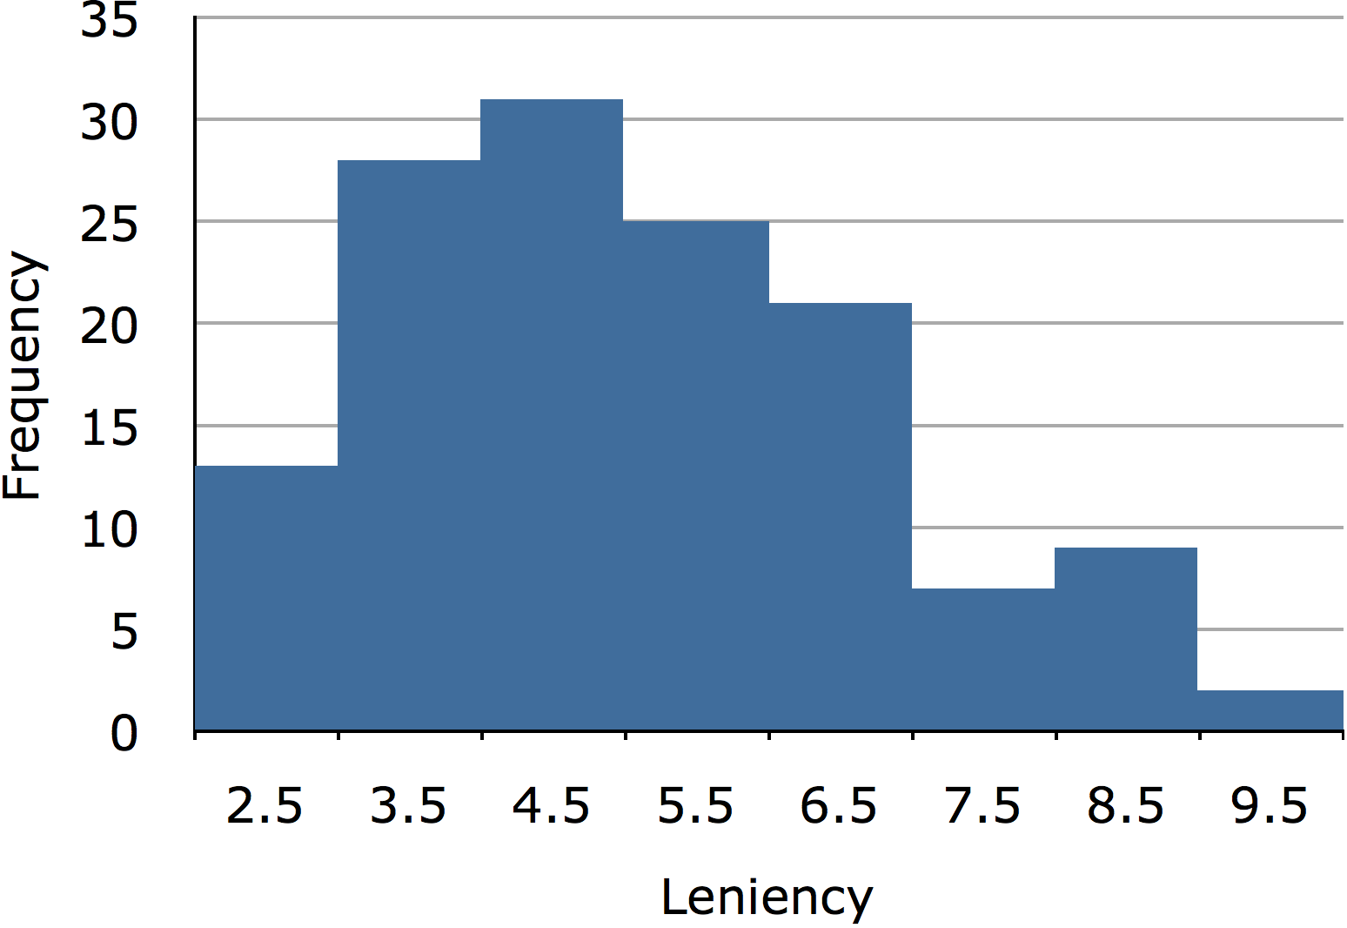
Sources of Variability
Notes:
Responses of subjects will vary in just about every experiment. Consider, for example, the "Smiles and Leniency" case study. A histogram of the dependent variable "leniency" is shown here. It is clear that the leniency scores vary considerably. There are many reasons why the scores differ. One, of course, is that subjects were assigned to four smile different conditions and the condition they were in may have affected their leniency score. In addition it is likely that some subjects are generally more lenient than others thus contributing to the differences among scores. There are many other possible sources of differences in leniency ratings including, perhaps, that some subjects were been in better moods than other subjects and/or that some subjects reacted more negatively than others to the looks or mannerisms of the stimulus person. You can imagine that there are innumerable other reasons why the scores of the subjects could differ.

Slide 126
Proportion of Variance Explained
Variance = 2.794
Mean variance = 2.649
SSQ “smiling”/(SSQ Total)
27.544/377.189 = 0.073
7.3% of the variance is explained by smiling condition
Notes:
One way to measure the effect of conditions is to determine the proportion of the variance among subjects' scores that is attributable to conditions. In this example, the variance of scores is 2.794. The question is how this variance compares with what the variance would have been present if every subject had been in the same treatment condition. We estimate this by computing the variance within each of the treatment conditions and taking the mean of these variances. For this example, the mean of the variances is 2.649. Since the variance within the smile conditions is not that much less than the variance ignoring conditions, it is clear that "smile condition" is not responsible for a high percentage of the variance. The most convenient way to compute the proportion explained is in terms of the sum of squares "conditions" and the sum of squares total. For the present data, the sum of squares for "Smiling Condition" is 27.544 and the sum of squares total is 377.189. Therefore, the proportion explained by "Smiling Condition" is:27.544/377.189 = 0.073.Thus 0.073 or 7.3% of the variance is explained by smiling condition.

Slide 127
Proportion Reduction in Error
SSQ (total) = 377.189
SSQ (Error) = 377.189 - 27.544 349.654
377.189 - 349.654 = 27.535
27.535/377.189 = 0.073
Notes:
An alternative way to look at the variance explained is as the percent reduction in error. The Sum of Square Total (377.189) represents the variation when "Smiling Condition" is ignored and the Sum of Squares Error (377.189 - 27.544 = 349.654) is the variation left over when "Smiling Condition" is accounted for. The difference between 377.189 and 349.654 is 27.535. The reduction in error of 27.535 represents a proportional reduction of 27.535 divided by 377.189 = 0.073, the same value as computed in terms of proportion of variance explained.

Slide 128
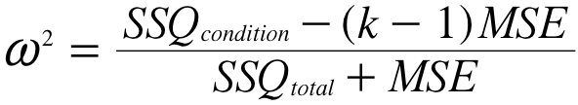
Measures
η² (eta squared)
η² ⁼ SSQ(condition)/SSQ(total)
ω² (omega squared)
Notes:
This measure of effect size, whether computed in terms of variance explained or in terms of percent reduction in error, is called eta squared where eta is the Greek letter eta. Unfortunately, eta squared tends to overestimate the variance explained and is therefore a biased estimate of the proportion of variance explained. As such, it is not recommended (despite the fact that it is often reported by a leading statistics package). An alternative measure, omega squared is unbiased and can be computed as shown where k is the number of conditions. For this example, k = 4 and omega squared = 0.052.

Slide 129
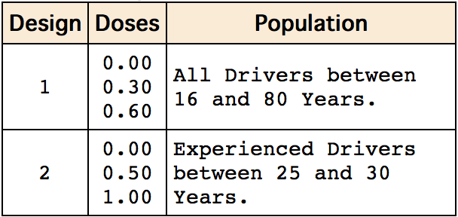
Variability Effects
Notes:
It is important to be aware that both the variability of the population sampled and the specific levels of the independent variable are important determinants of the proportion of variance explained. Consider two possible designs of an experiment investigating the effect of alcohol consumption on driving ability. As can be seen, Design 1 has a smaller range of doses and a more diverse population than Design 2. What are the implications for the proportion of variance explained by Dose? Variation due to Dose would be greater in Design 2 than Design 1 since alcohol is manipulated more strongly than in Design 1. However, the variance in the population should be greater in Design 1 since it includes a more diverse set of drivers. Since with Design 1 the variance due to Dose would be smaller and the total variance would be larger, the proportion of variance explained by Dose would be much less using Design 1 than using Design 2. Thus, the proportion of variance explained is not a general characteristic of the independent variable. Instead, it is dependent on the specific levels of the independent variable used in the experiment and the variability of the population sampled.

Slide 130
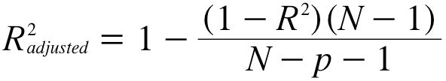
Correlational Studies
SSQ_{y} = SSQ_{explained} + SSQ_{error}
SSQ_{explained} / SSQ_{y} is proportion explained
In simple regression: r²
In multiple regression: R²
Notes:
In the section "Partitioning the Sums of Squares" in the Regression chapter, we saw that the sum of squares for Y (the criterion variable) can be partitioned into the sum of squares explained and the sum of squares error. The proportion of variance explained in multiple regression is therefore: SSQexplained divided by SSQtotal.
In simple regression, the proportion of variance explained is equal to r squared; in multiple regression it is equal to multiple R squared. In general R squared is analogous to eta squared and is a biased estimate of the variance explained. The formula for adjusted R squared is analogous to omega squared and is less biased (although not completely unbiased) where N is the total number of observations and p is the number of predictor variables.

